Slide 1
Proposed Service Changes 2018
Route 90 – Midday Service to Milestone
Route 76 – Saturday Service added
Route 43 – Sunday Service added

Slide 2
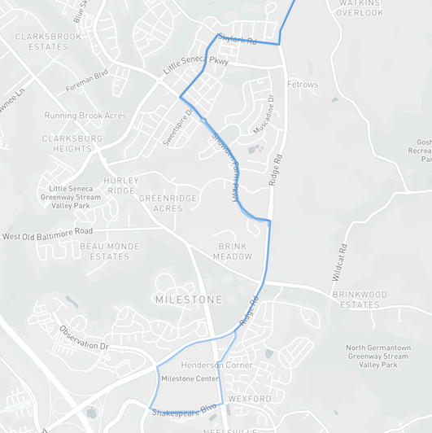
Proposed Service Changes Route 90
Route 90
Route 90
Route 90 will extend to Milestone Transit Center during the middle of the day.
Midday Hours:
From Milestone: 9:46am – 3:15pm
From Shady Grove: 9:17am – 2:47pm
Service Area
Shady Grove Metro, Damascus, Clarksburg and Milestone Transit Center
Inset

Slide 3
Proposed Service Changes 2018
Route 43
Traville Transit Center to Shady Grove Station via Shady Grove Hospital
New Service Expansion:
Sunday service
Frequency:
30 minutes
Span of Service:
7:10 am – 8:25 pm
From Traville Transit Center
6:40 am – 8:00 pm
From Shady Grove
Route 76
Quince Orchard to Shady Grove via Kentlands
New Service Expansion:
Saturday service
Frequency:
30 minutes
Span of Service:
6:45 am – 7:15 pm
From Shady Grove
7:11 am – 7:41 pm
From Quince Orchard

